Slide 1
WEB DESIGNING
PROJECT BY
NAME:ISHAN ARORA
ROLL NO:51555102717
BRANCH AND YEAR:CSE 3RD YEAR
COLLEGE NAME:MVSIT

Slide 2
PROJECT ON HOTEL WEBSITE MADE FOR ITS
PROMOTION
FACILITIES INFORMATION
LOCATION
TIMINGS
MENU
BOOKINGS
AWARDS

Slide 3
ELEMENTS USED IN WEBSITE
HTML
ADVANCED CSS
JAVASCRIPT
BOOTSTRAP
JQUERY
CORE JAVA
JDBC

Slide 4
IDE USED
BRACKETS
NETBEANS

Slide 5
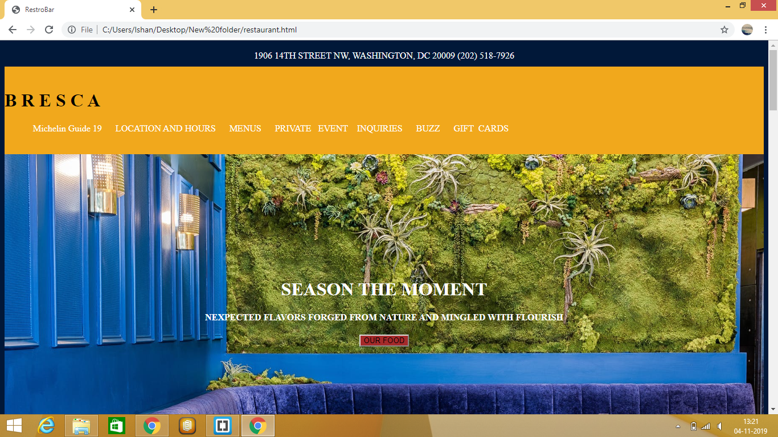
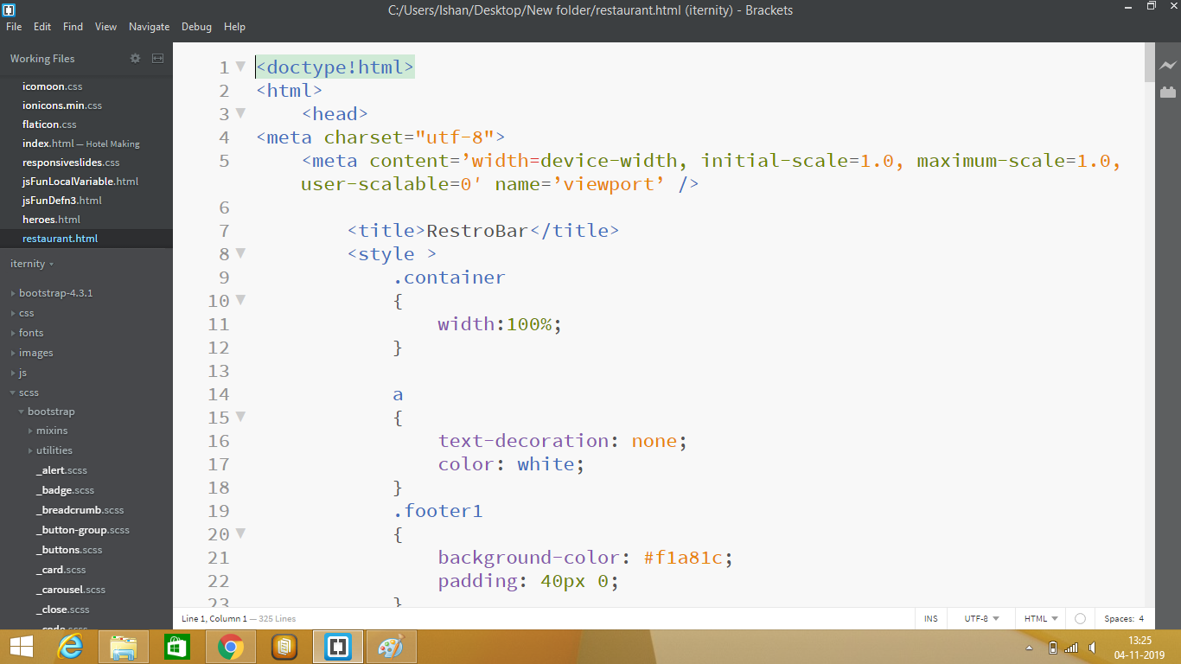
LAYOUT 1

Slide 6
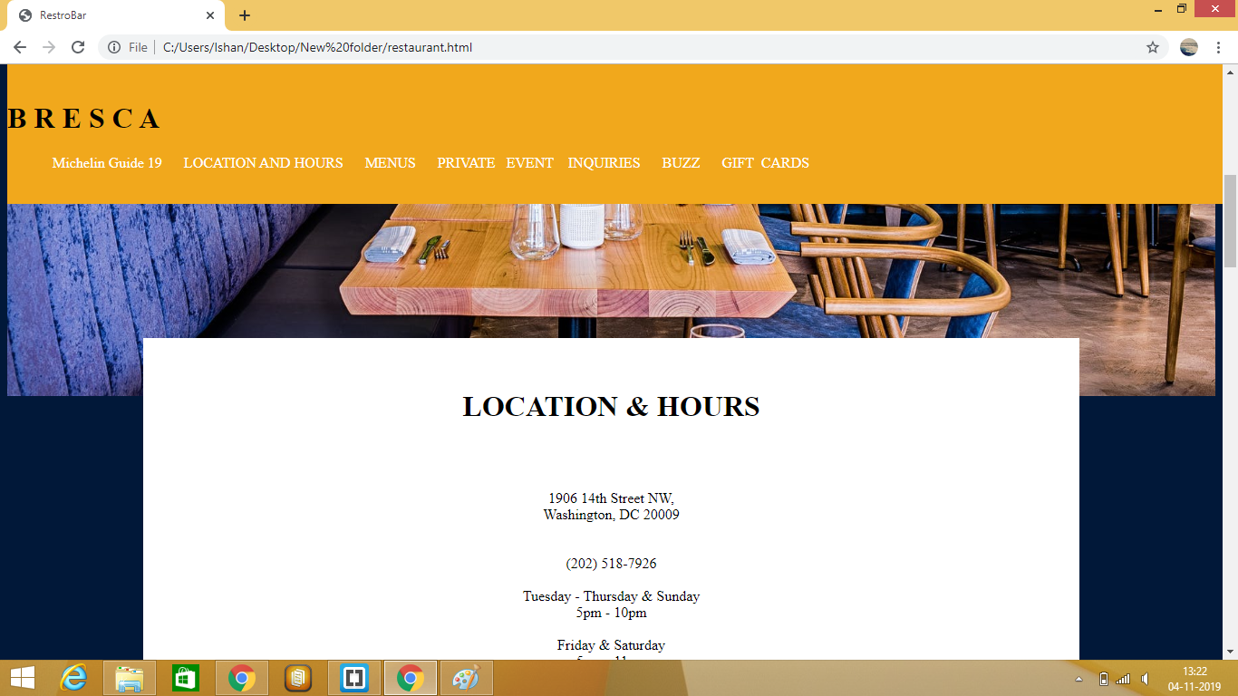
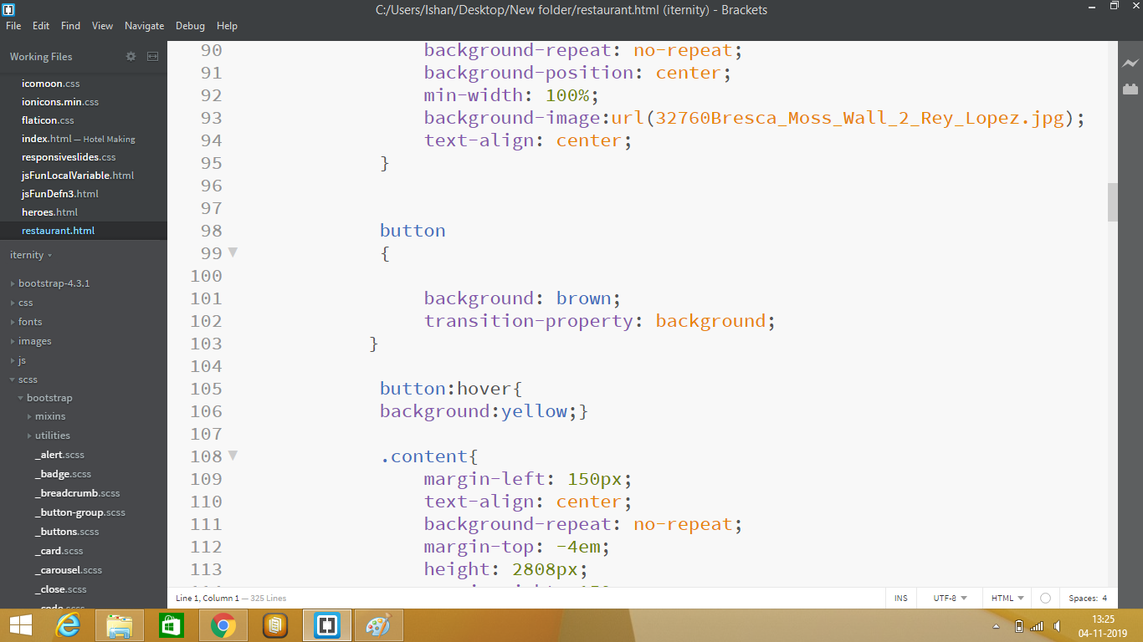
LAYOUT 2

Slide 7
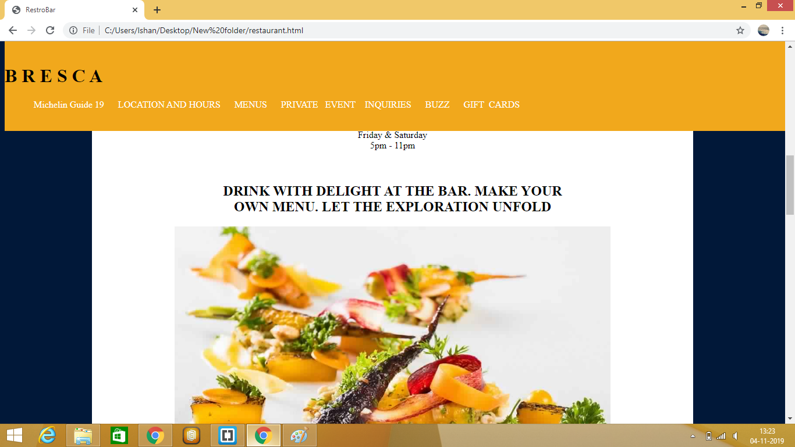
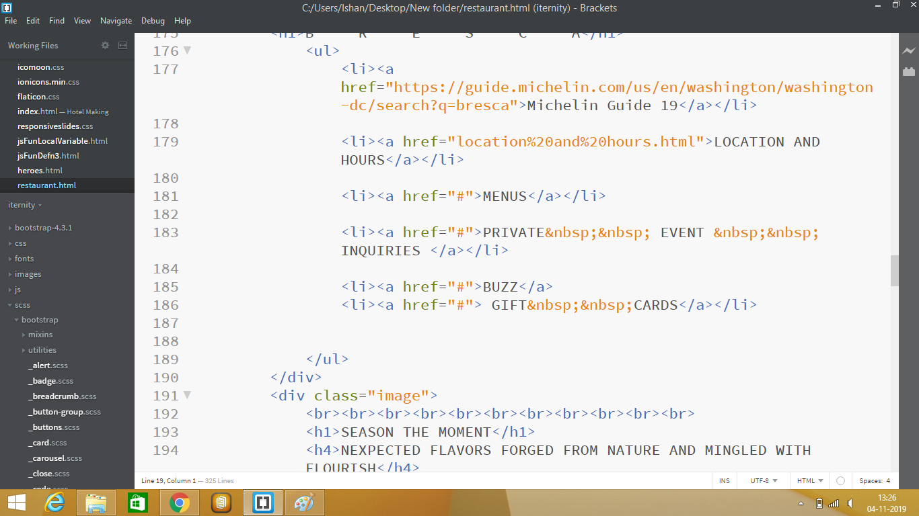
LAYOUT 3

Slide 8
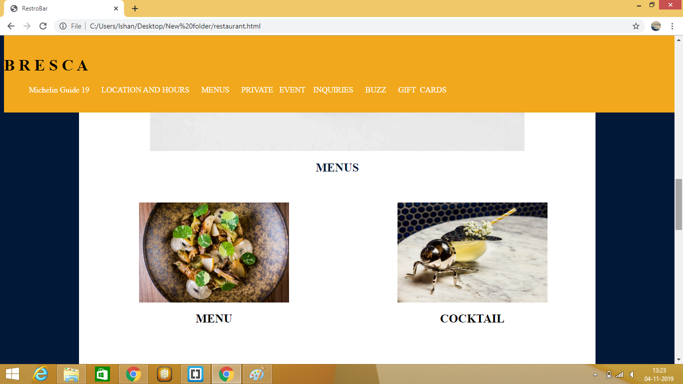
LAYOUT 4

Slide 9
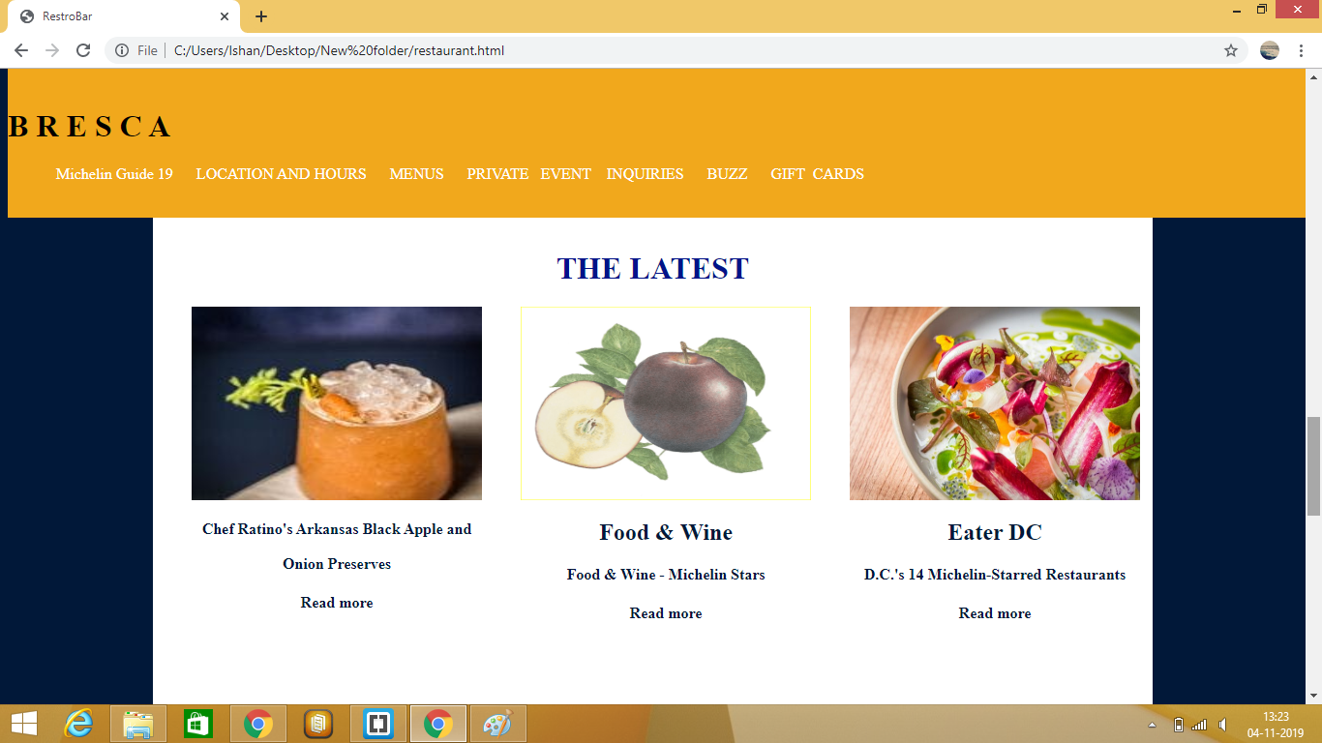
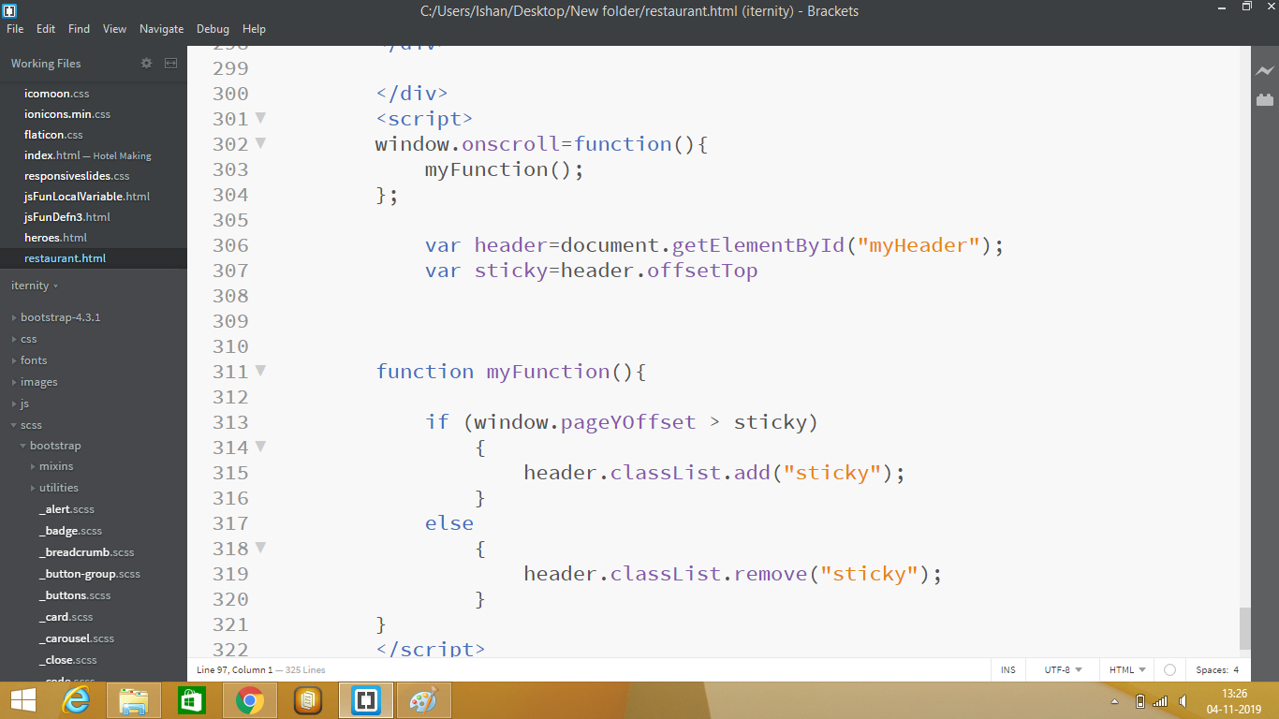
LAYOUT 5

Slide 10
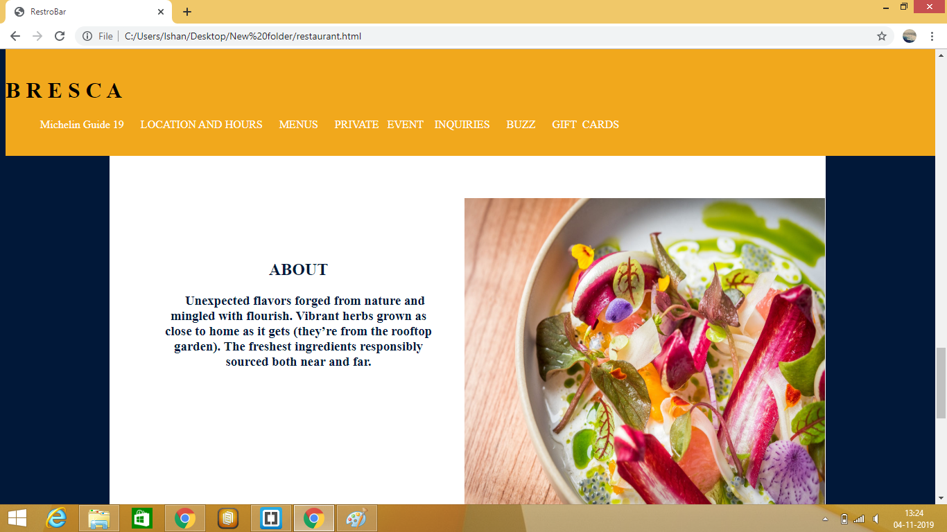
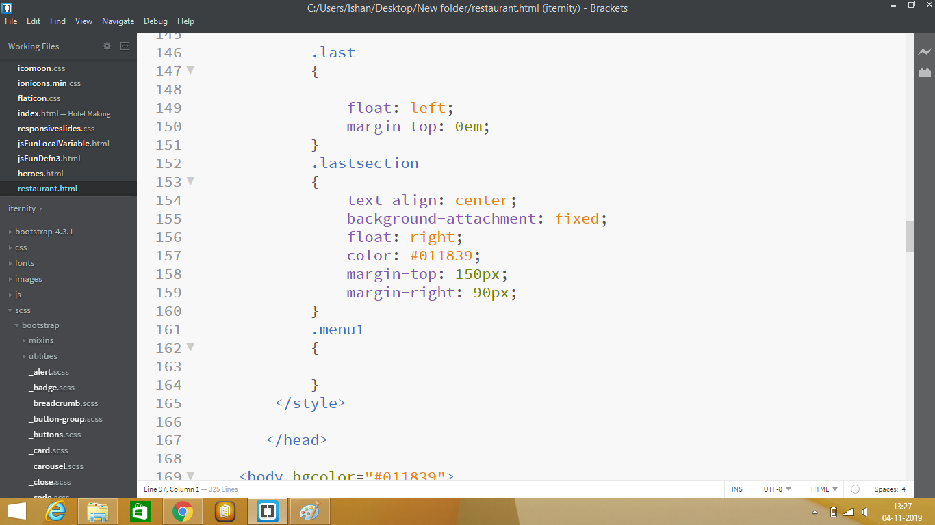
LAYOUT 6

Slide 11
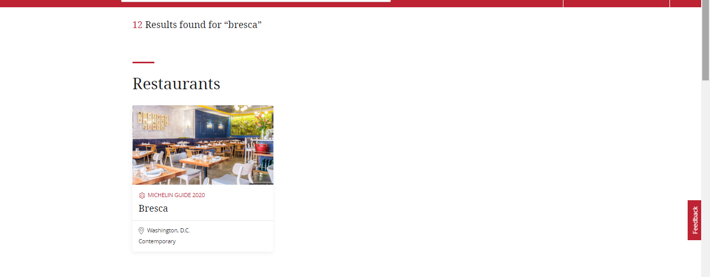
BRESCA AWARDED AS BEST RESTAURANT

Slide 12
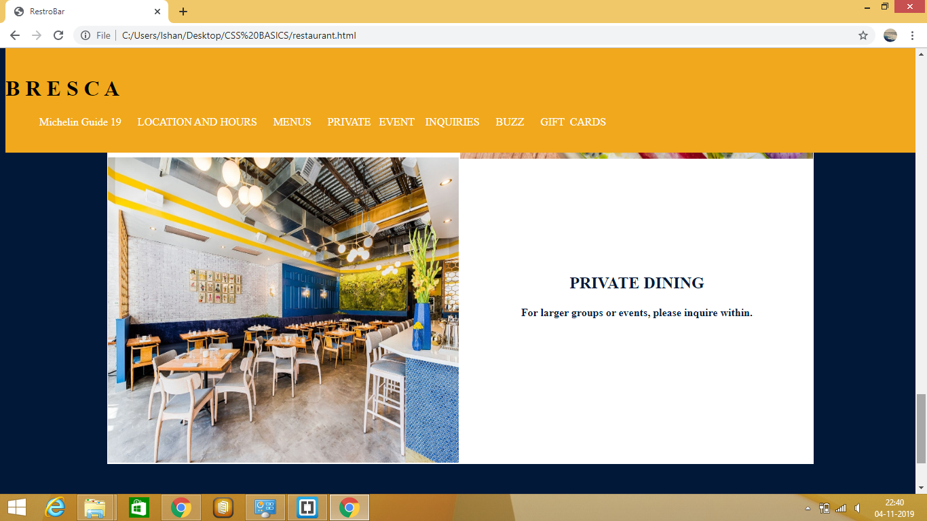
PRIVATE DINING ROOM

Slide 13
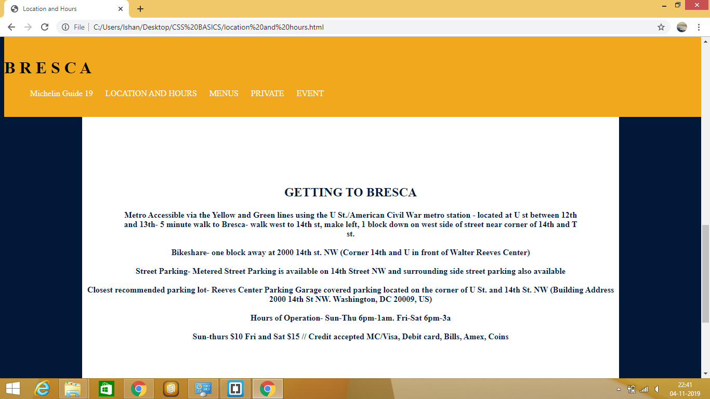
LOCATION AND HOURS OF RESTAURANT

Slide 14
JDBC
What is JDBC?
JDBC stands for Java Database Connectivity, which is a standard Java API for database-independent connectivity between the Java programming language and a wide range of databases.
The JDBC library includes APIs for each of the tasks mentioned below that are commonly associated with database usage.
Making a connection to a database.
Creating SQL or MySQL statements.
Executing SQL or MySQL queries in the database.
Viewing & Modifying the resulting records.
Fundamentally, JDBC is a specification that provides a complete set of interfaces that allows for portable access to an underlying database. Java can be used to write different types of executables, such as −
Java Applications
Java Applets

Slide 15
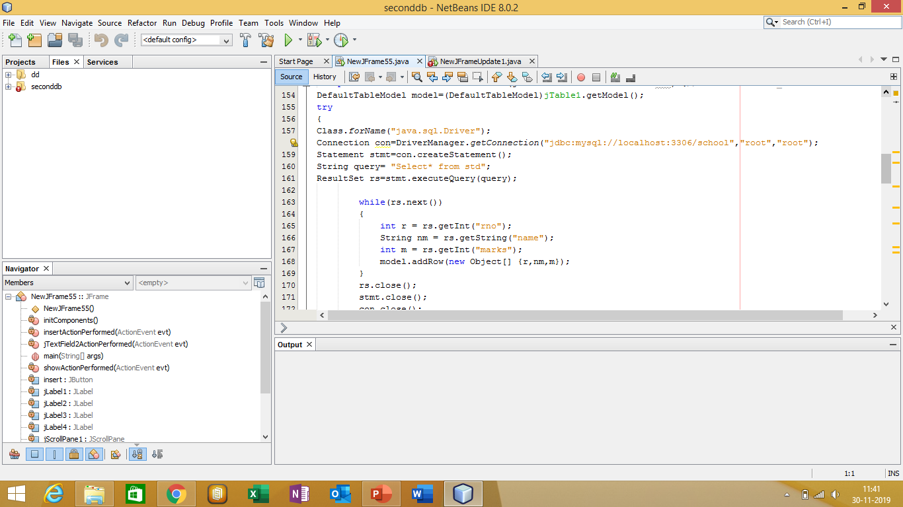
Jdbc code for basic linking

Slide 16
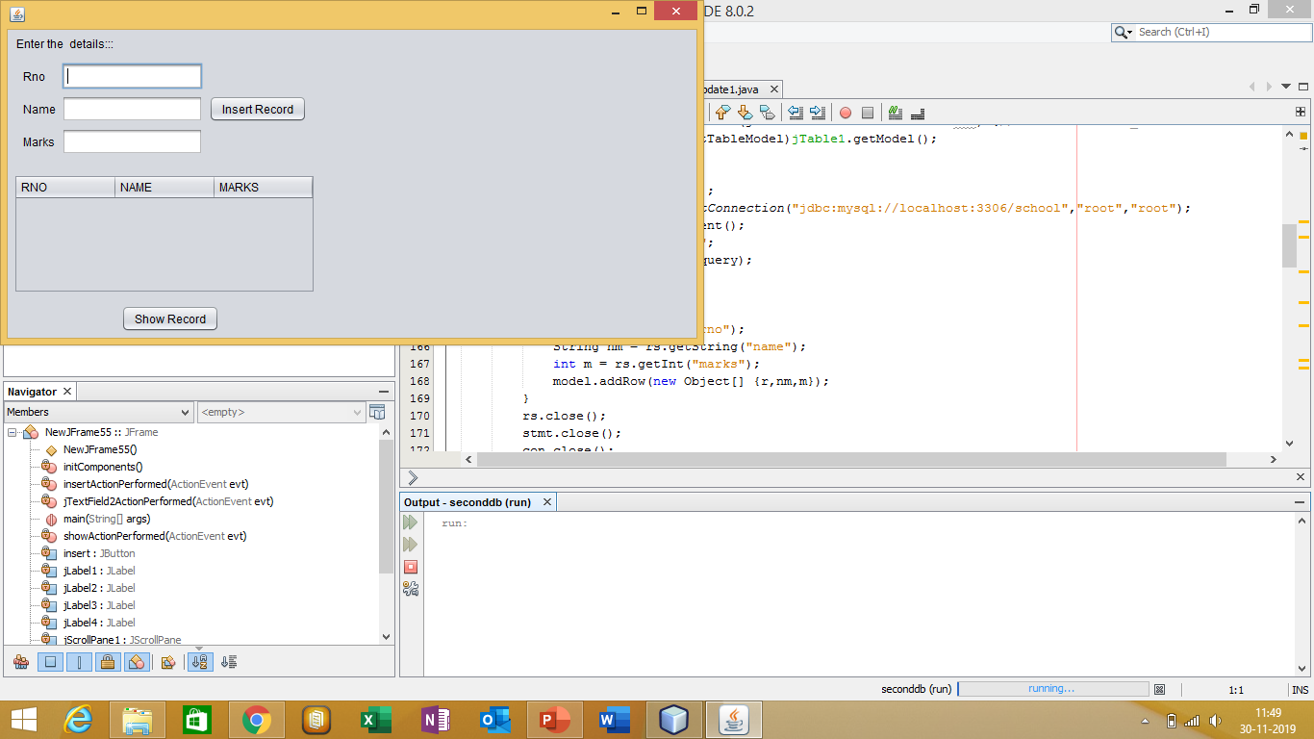
Jdbc outputs

Slide 17
THANK YOU FOR VISITING OUR RESTAURANT

